Slide 1

Dheeraj Dhingani
OpenVirus Intern

Slide 2
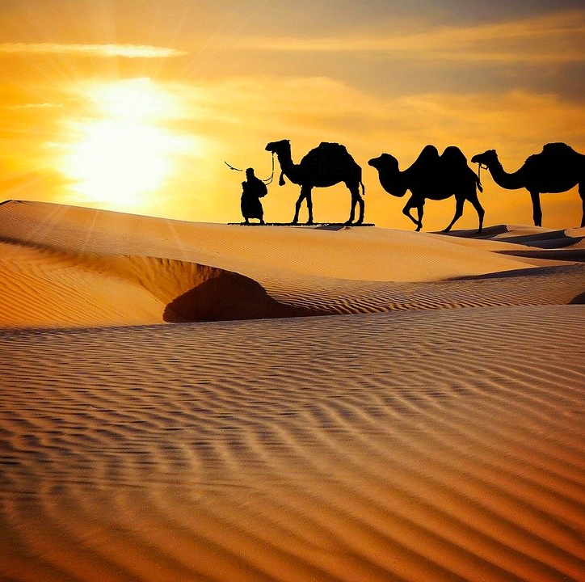
About me
I am from the Kishangarh Village in Rajasthan, India
BSc (Math), RR college Alwar
There are many constraints here:
Erratic internet
Lack of access to technology
Despite this, I worked very hard and learnt many things!

Slide 3
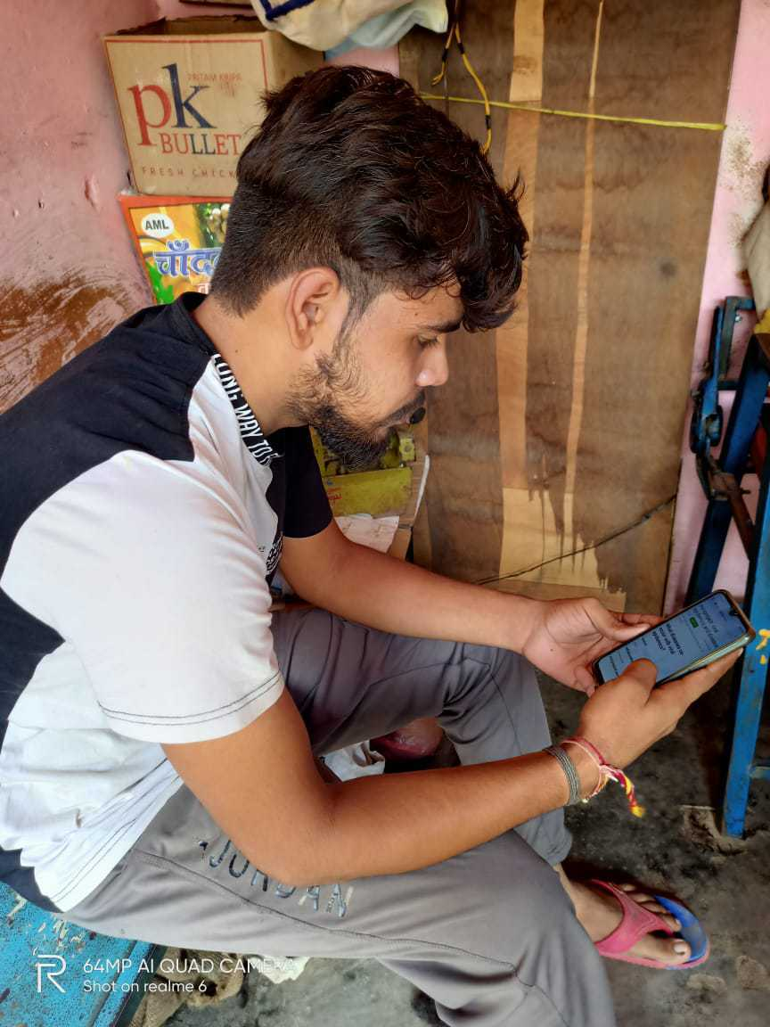
I don’t have a computer Did all the work on my Smart Phone

Slide 4
What I learnt with OpenVirus
Working in a Team
Support and friendship
Lots of things about computers
Science
How technology can improve scientific knowledge

Slide 5
I was introduced to an Ocean of New Knowledge
I learnt about
Dictionaries
WIKIDATA
How to use SPARQL
And I tried it all myself

Slide 6
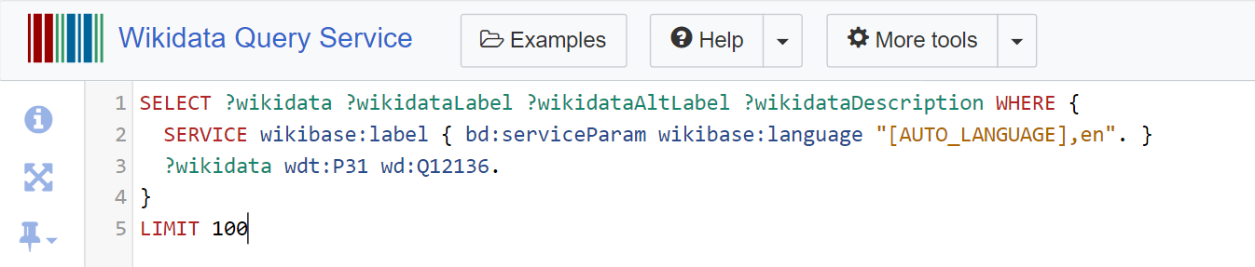
The query I used

Slide 7
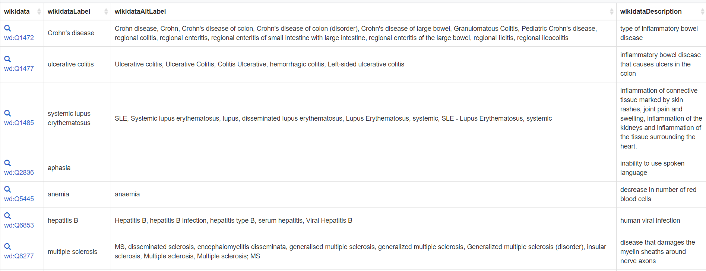
SPARQL Results

Slide 8
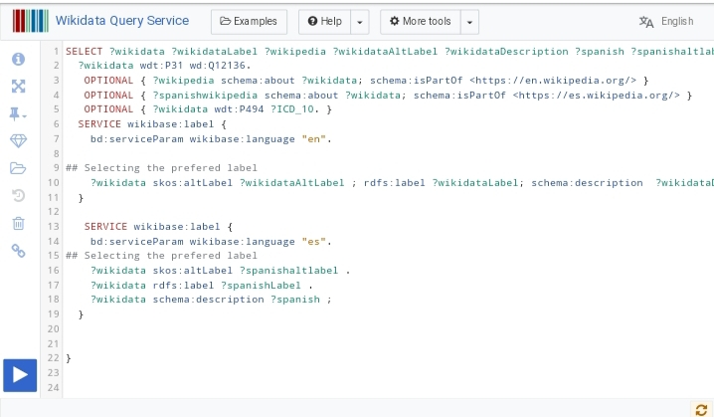
SPARQL Query for Multilingual Dictionary (Spanish)

Slide 9
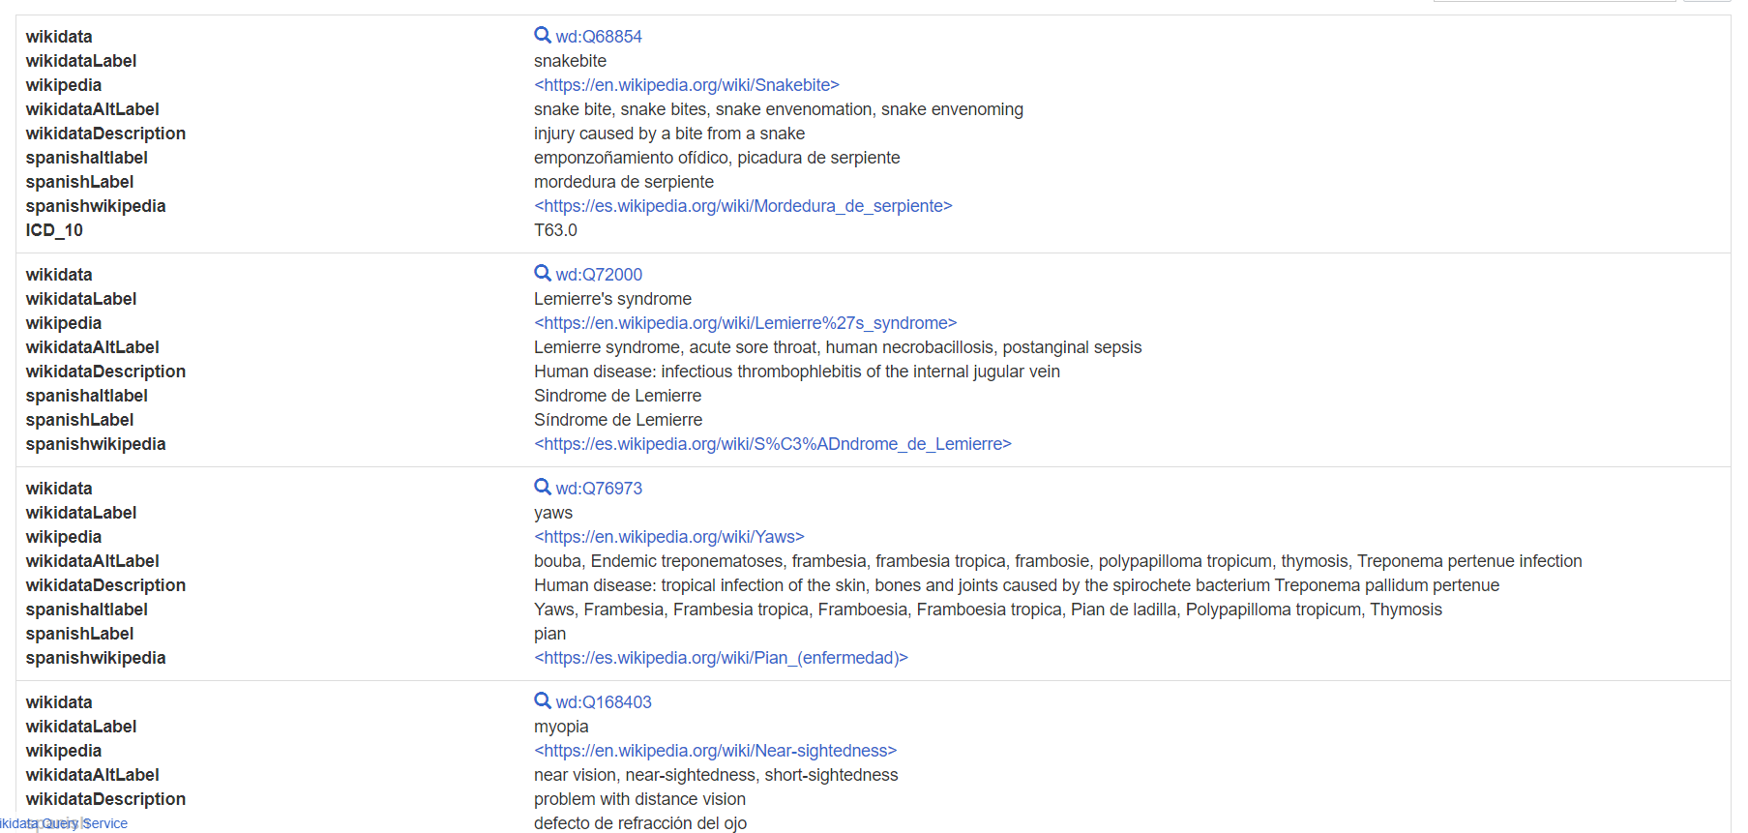
SPARQL Results for Multilingual Dictionary (Spanish)

Slide 10

It is great to be here
Thank you

